Slide 1

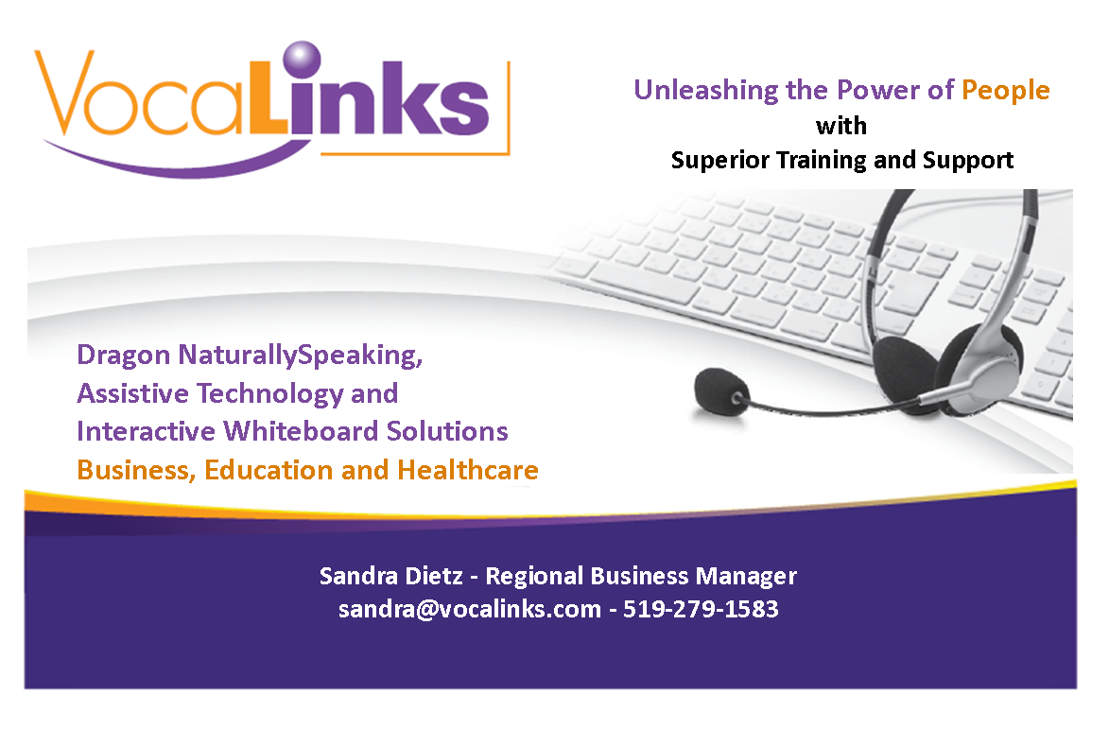

VocaLinks
Speech Recognition Seminar
Speech Recognition
Assistive Technology, Consulting, Training, Sales and Support

Slide 2

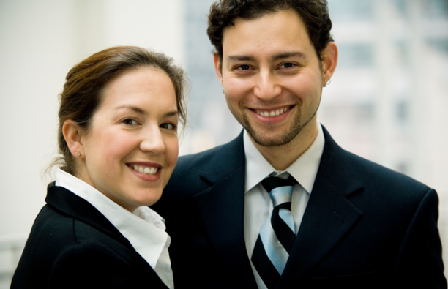

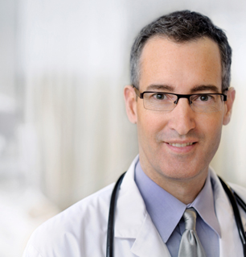
Overview
Established in 1998 providing Assistive Technology and Speech Recognition solutions for:
Business
Education
Healthcare
Dragon NaturallySpeaking, Kurzweil 3000,
WordQ, Inspiration and more!

Slide 3

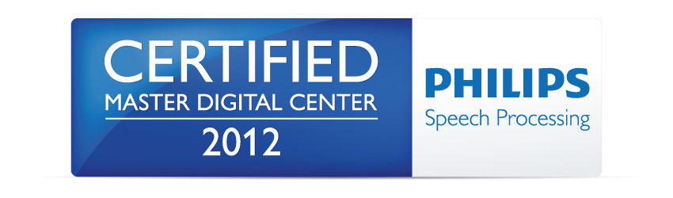

Certifications

Slide 4
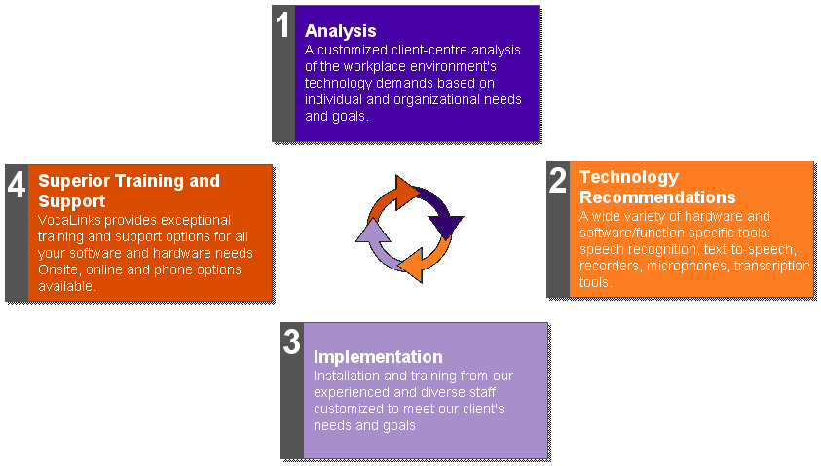
Proven Methodology

Slide 5

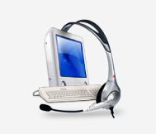


Superior Training & Support
Custom Training solutions for your specific needs:
Webinar
Technical Support
One to One

Slide 6
Benefits of Dragon
Types three times faster than the average person
Can be used in conjunction with virtually any Windows based software
Large vocabulary allowing users to add custom words and phrases
Navigate Internet Explorer by voice

Slide 7
Benefits of Dragon
Create custom commands to control
the mouse
Use a digital recorder to capture notes
on-the-go and have Dragon convert the
audio files to text
Compose and send emails entirely by voice
Increases productivity and minimizes repetitive stress and physical strain

Slide 8
Thinking...
1. What is your time worth to you?
2. Who do you know that could benefit
from using a Dragon solution?

Slide 9

Thinking...
What is your time worth to you?
If Dragon NaturallySpeaking could save
you 30 minutes a day, that's 2 1/2 hours
per week, what could you do with that
extra time?

Slide 10




Thinking...
What would you do with that extra time?

Slide 11
Thinking...
Who do you know that could use
Dragon for their own benefit?
Yourself - reports, email, database
Your clients - accident victims, workplace injuries,
call centers, disability claimants...
Your friends and colleagues
Your spouse or children...

Slide 12
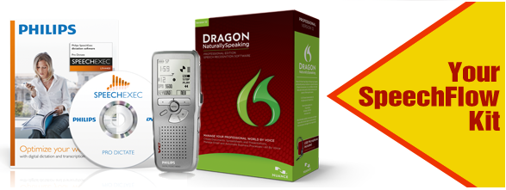
Current Promotions
Dragon NaturallySpeaking Professional
Philips Digital Recorder
SpeechExec Pro Dictate
Until April 30, 2013
$599

